Slide 1
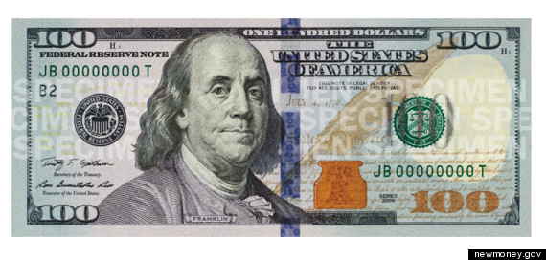
Discoveries and Inventions of Benjamin Franklin

Slide 3
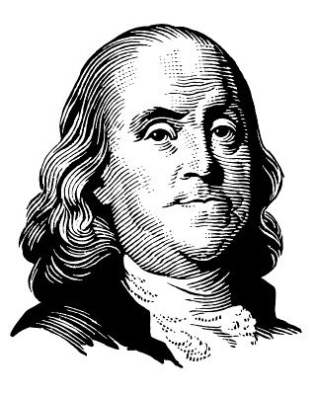
January 6, 1706] – April 17, 1790
Writer
Statesman
Diplomat
Printer
Publisher and political philosopher
Scientist & Inventor

Slide 4
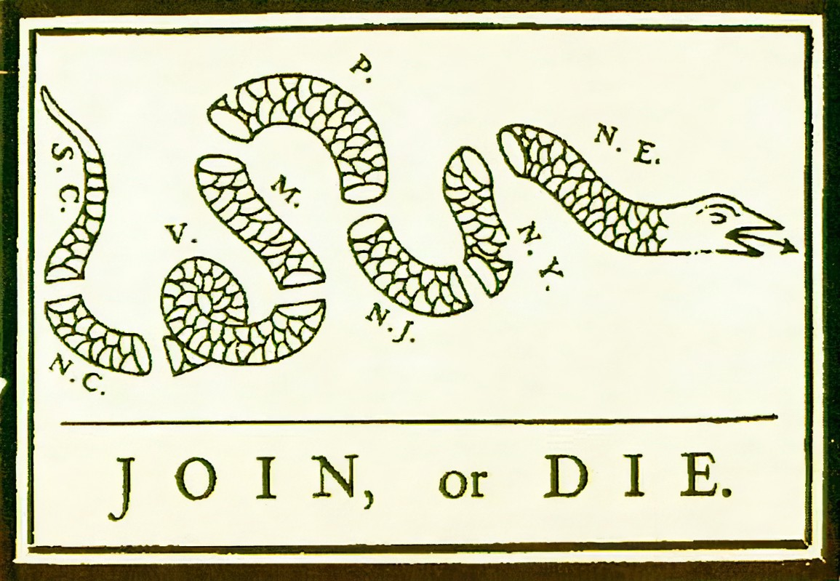
An early inventor of the idea of the colonies joining together The Pennsylvania Gazette on May 9, 1754

Slide 5
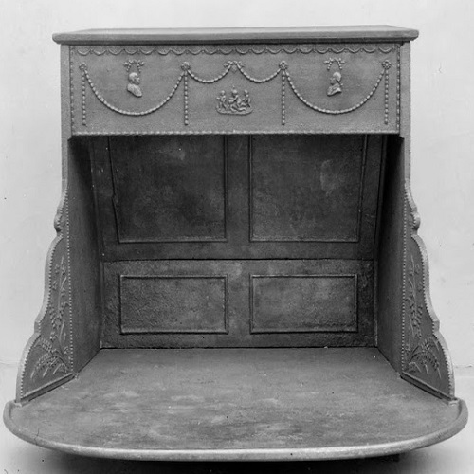
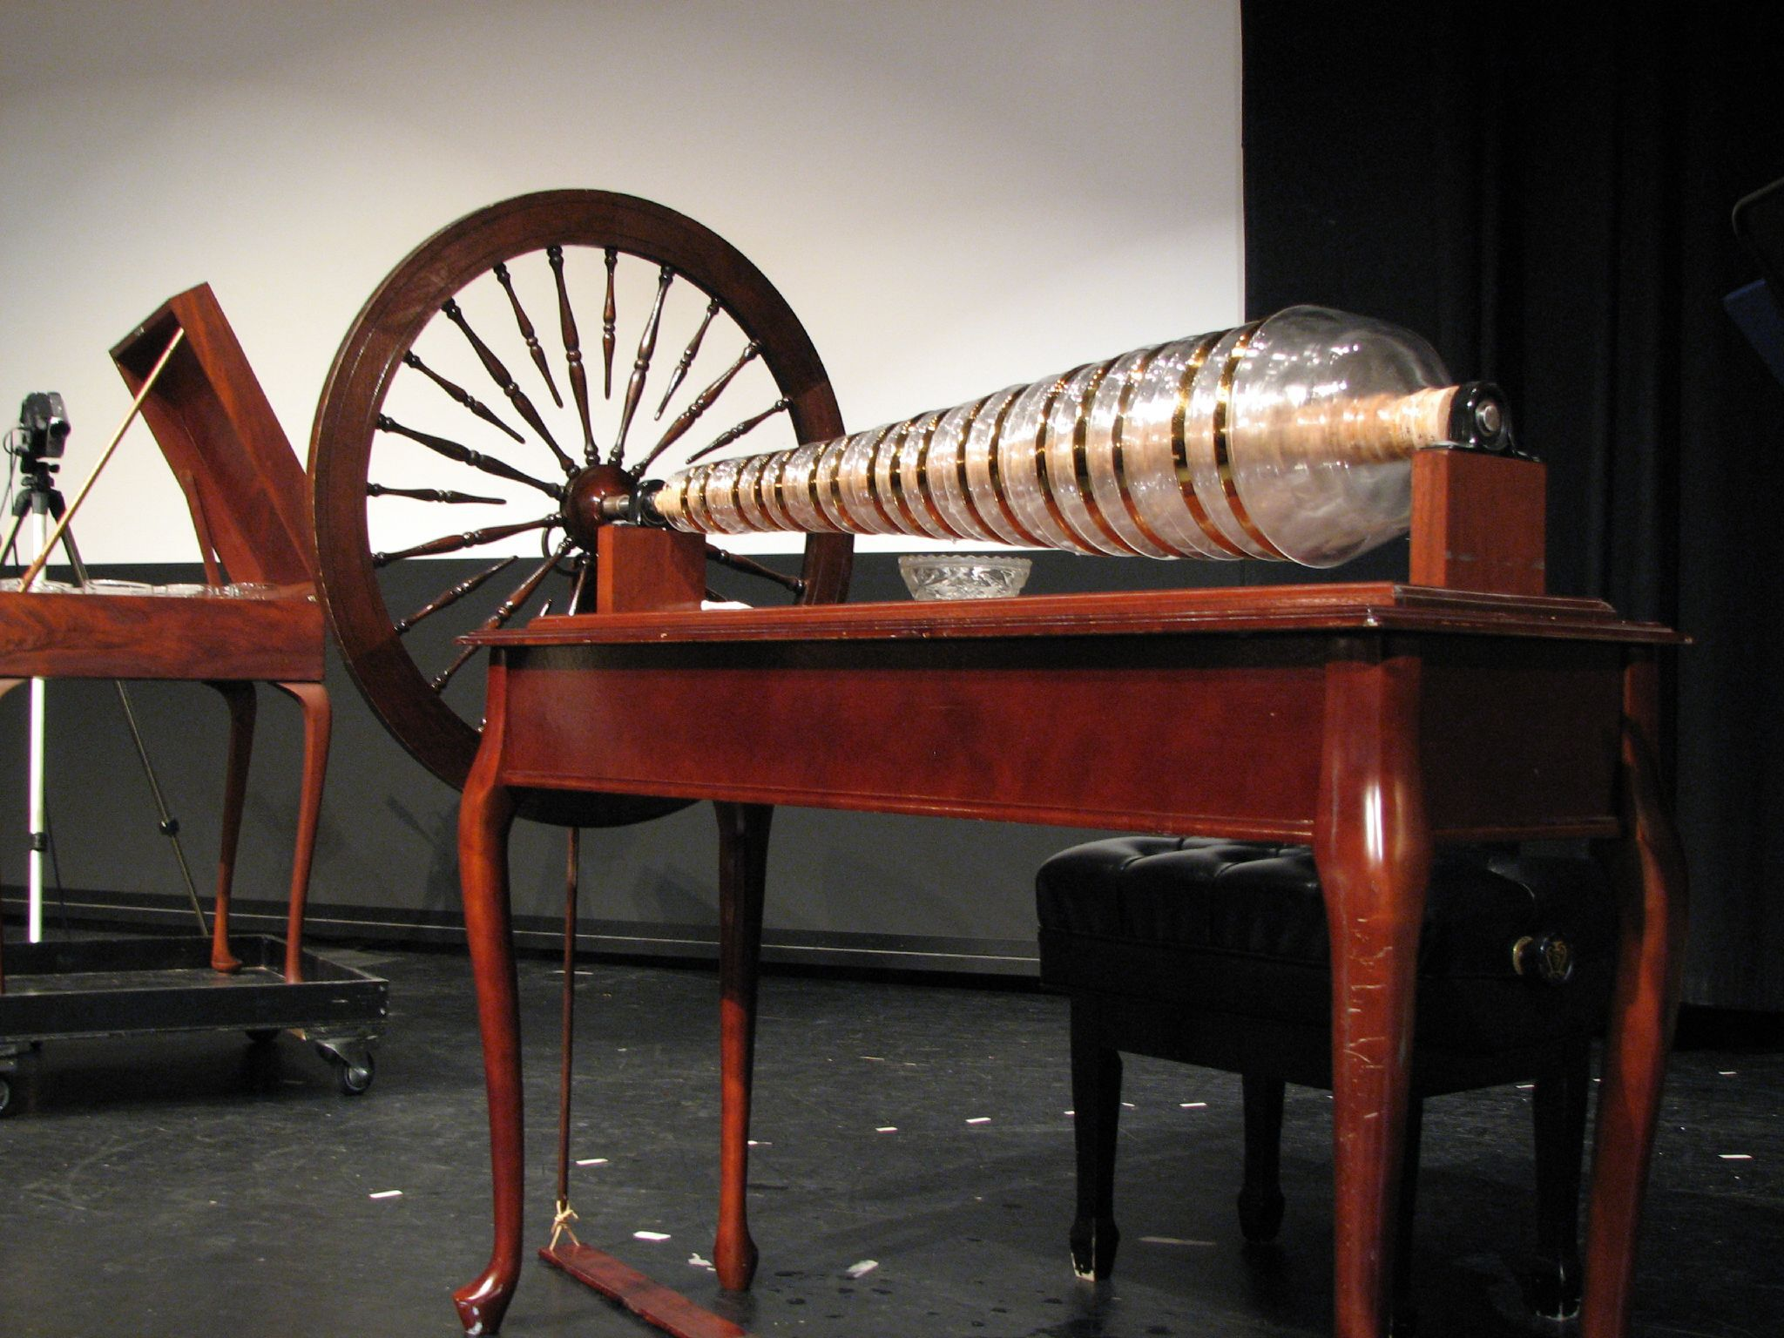
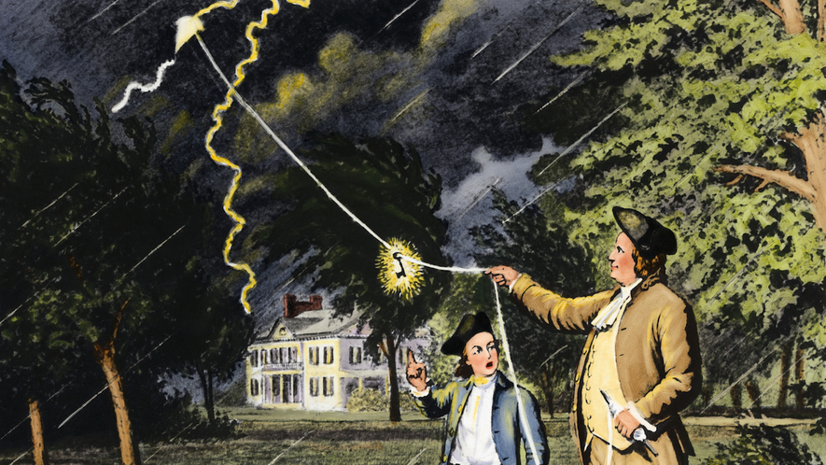
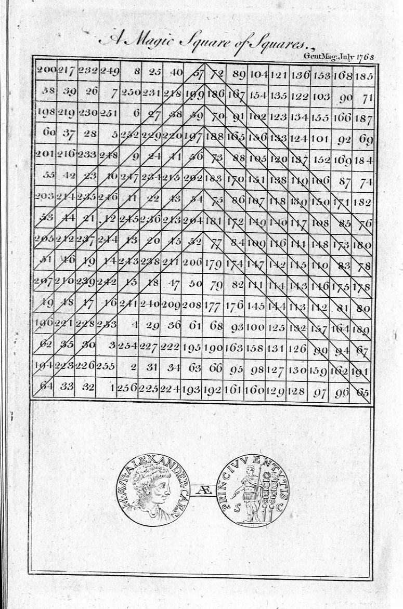
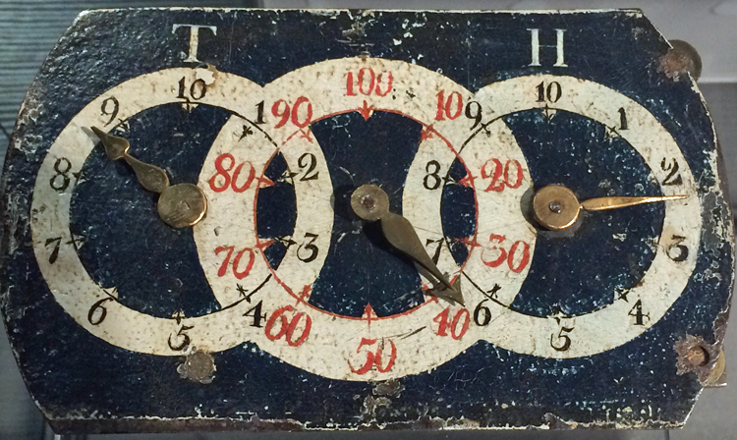
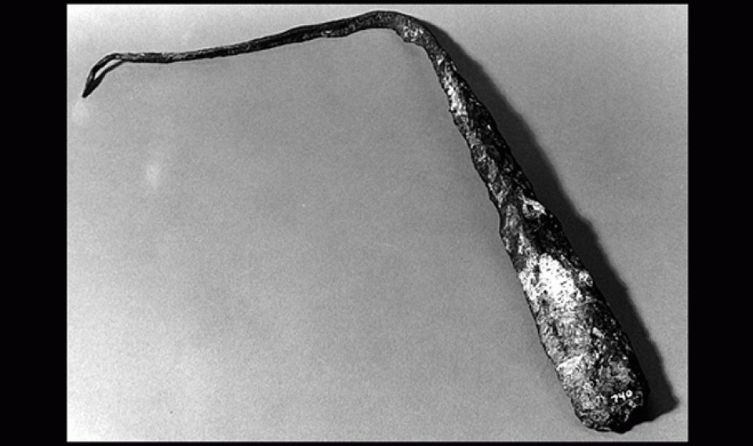
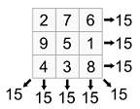
Armonica
The Lightning Rod
Franklin Stove
Odometer
Magic Squares

Slide 6
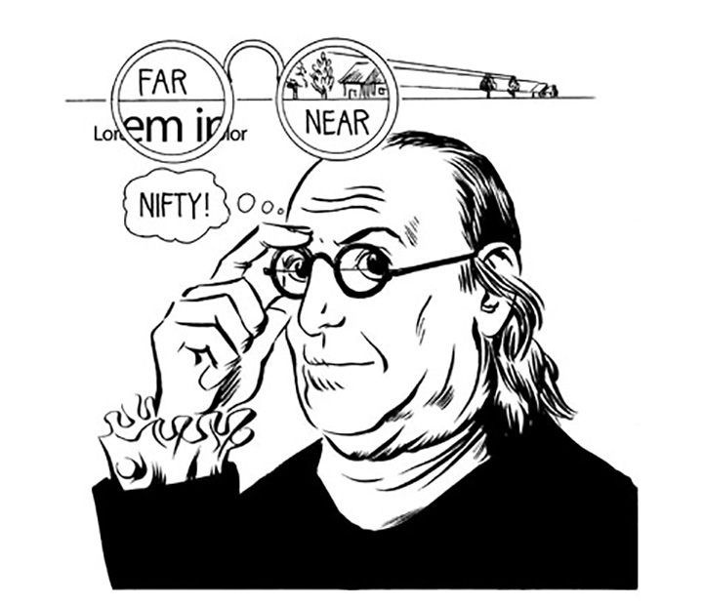
Double Spectacles aka Bifocals

Slide 7
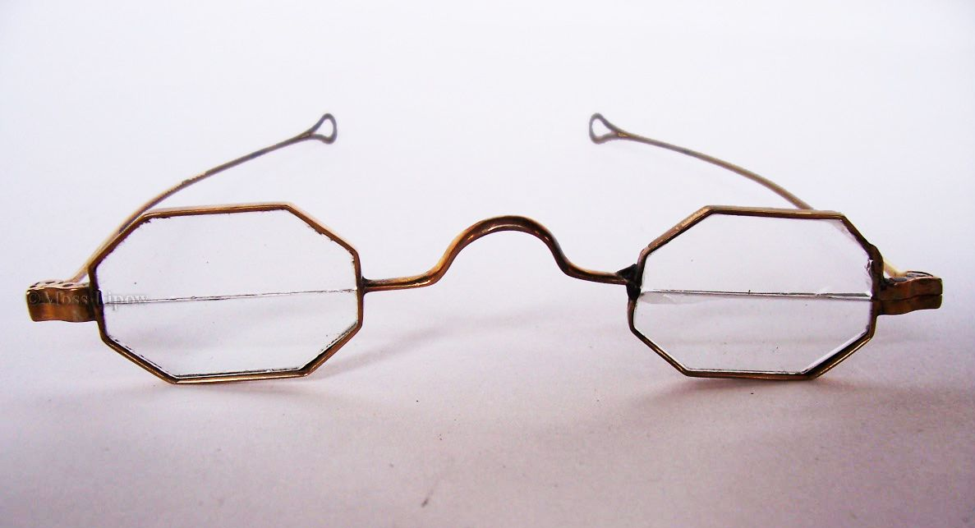
Double Spectacles

Slide 8
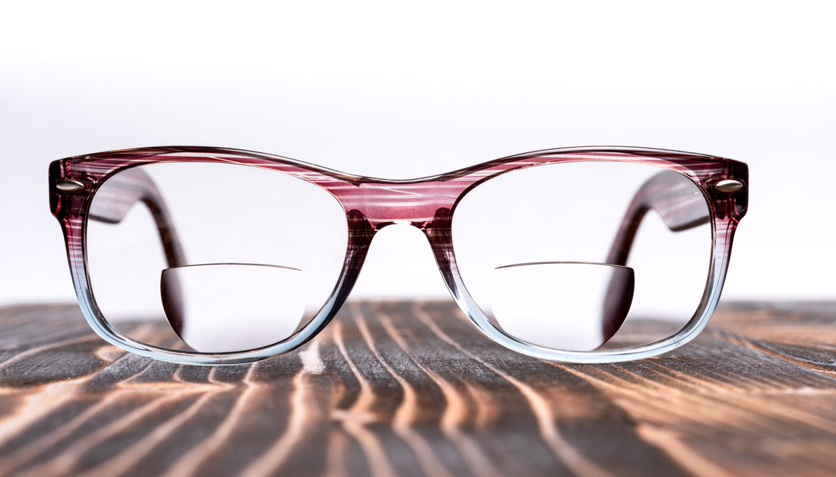
Modern Bifocals

Slide 9
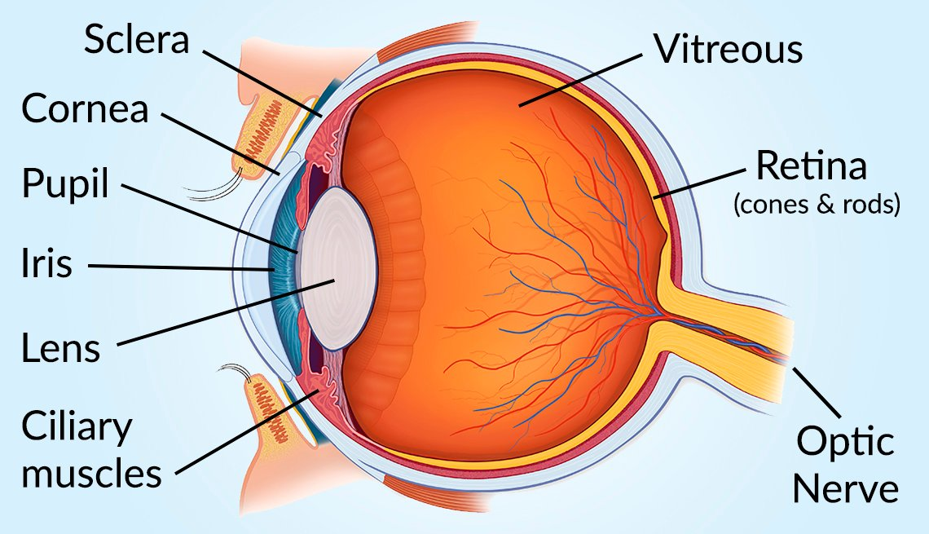

Slide 10
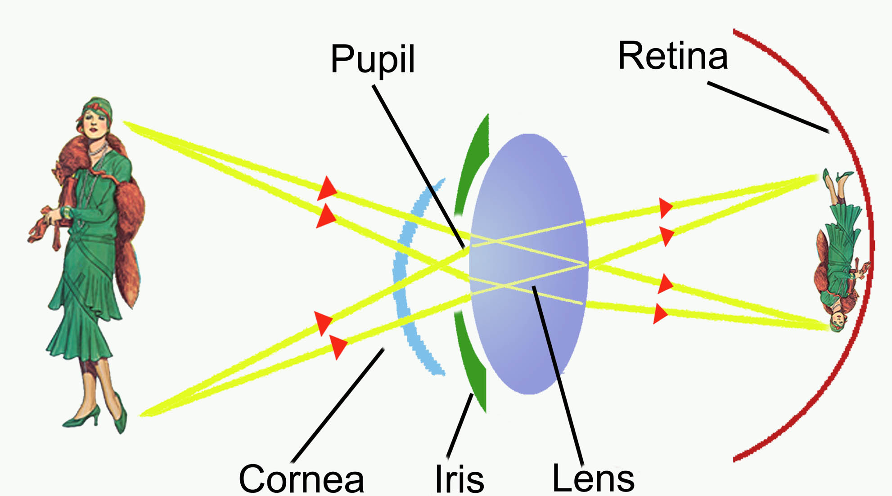

Slide 11
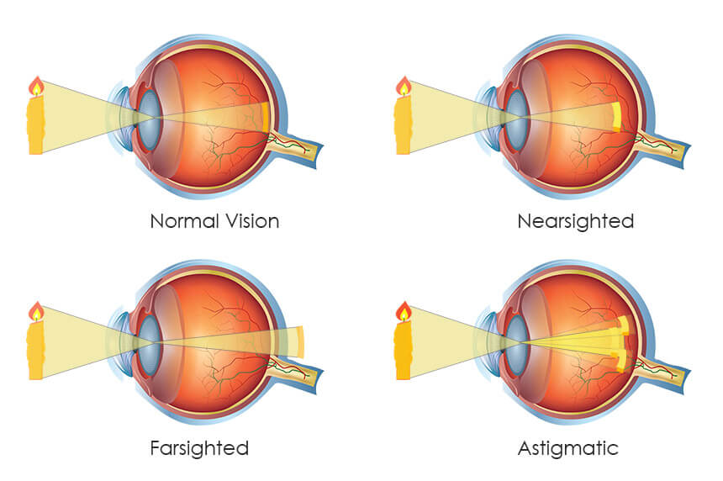

Slide 12
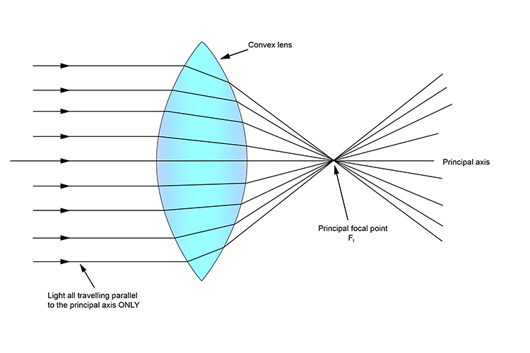
Refraction of light through a lens

Slide 13
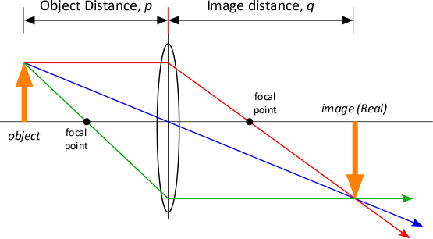

Slide 14
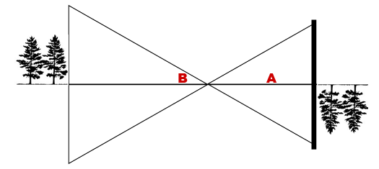
object lens focal point Real image
Magnified virtual right side up Inverted image

Slide 15
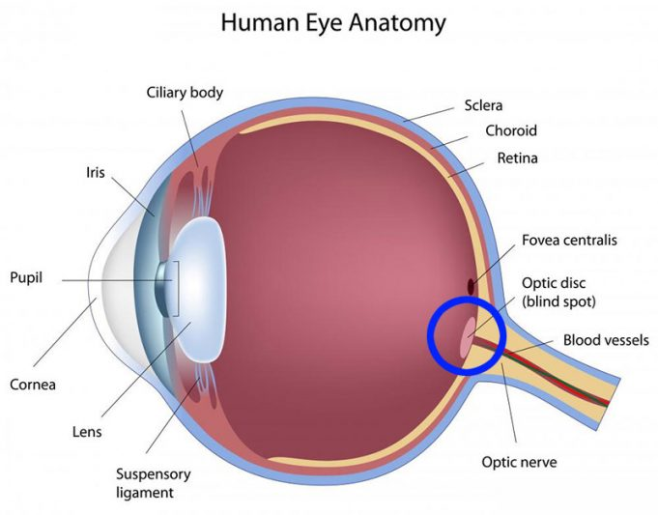
The Blind Spot

Slide 18
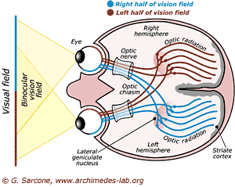

Slide 19
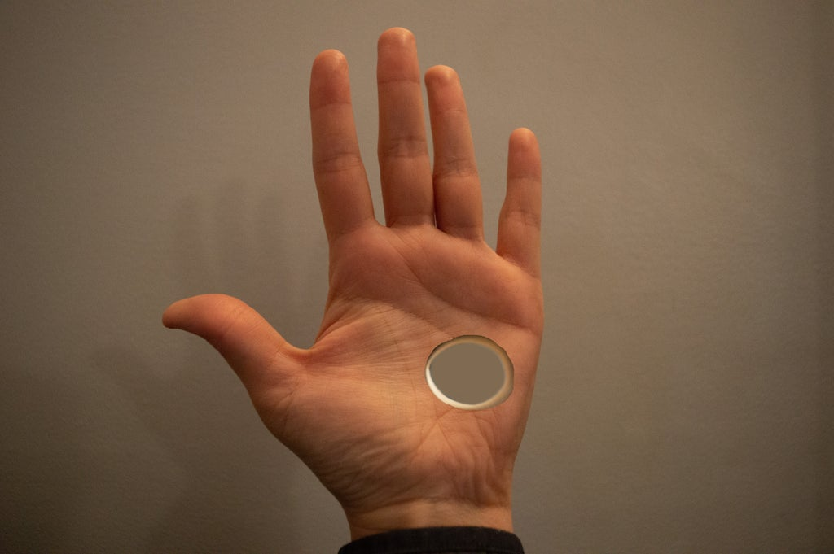
Stereo Vision Illusion
Floating Finger
Split pencil
Hole in your hand

Slide 20
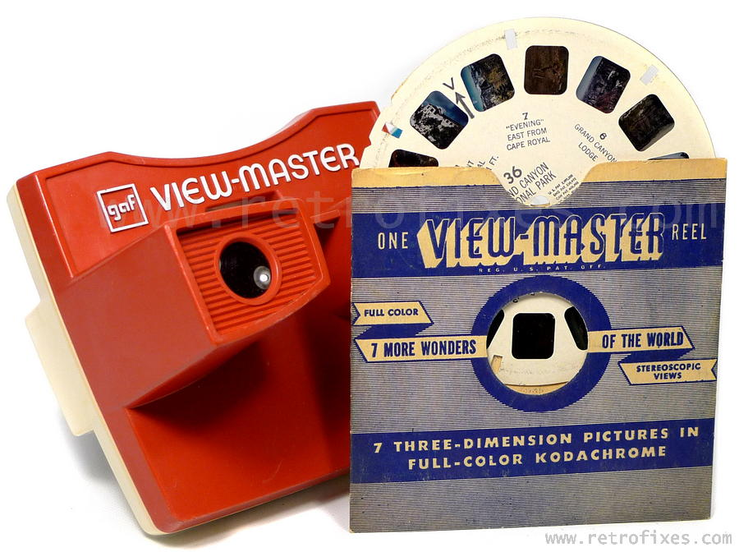

Slide 21
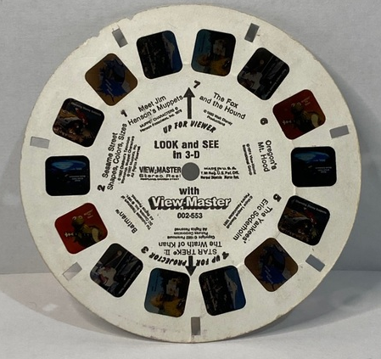

Slide 22
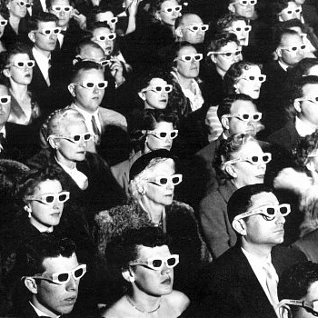
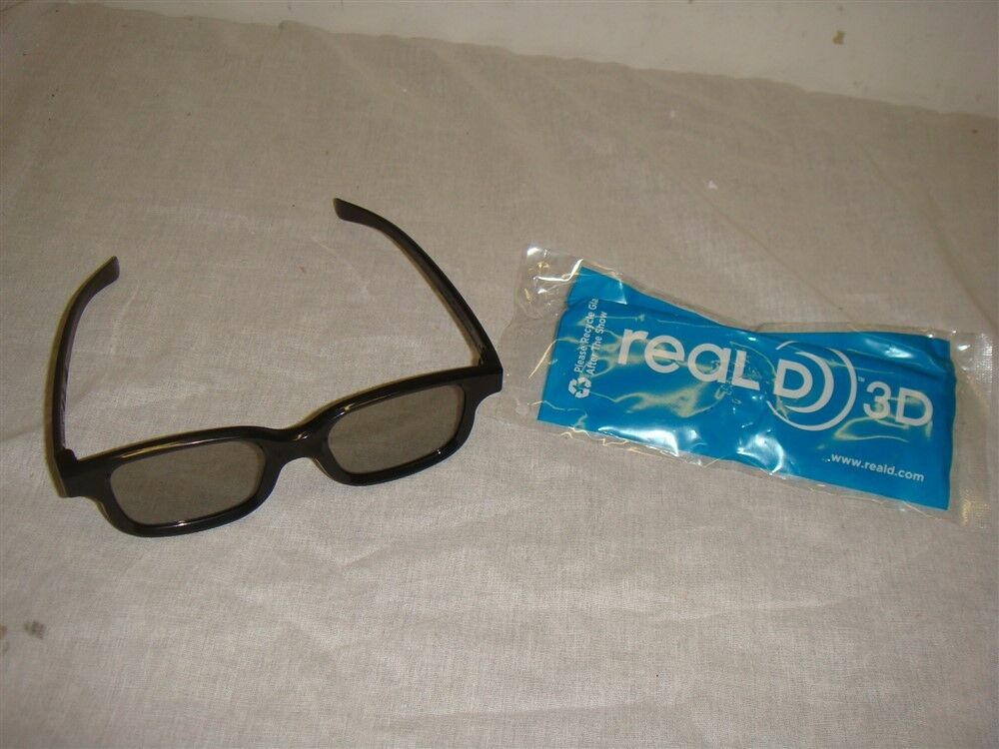
Polarized Lens
3-D Glasses

Slide 23
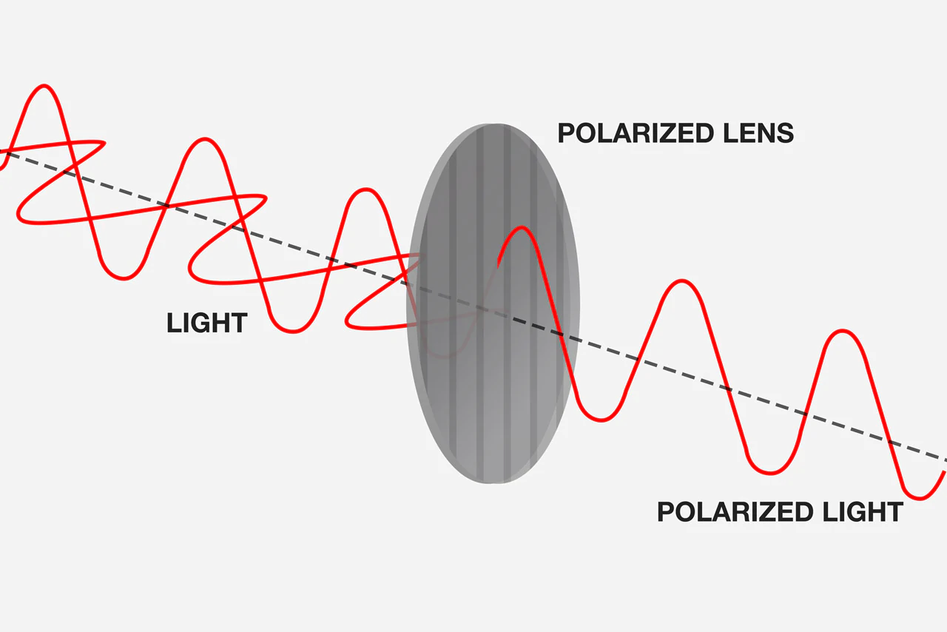

Slide 24
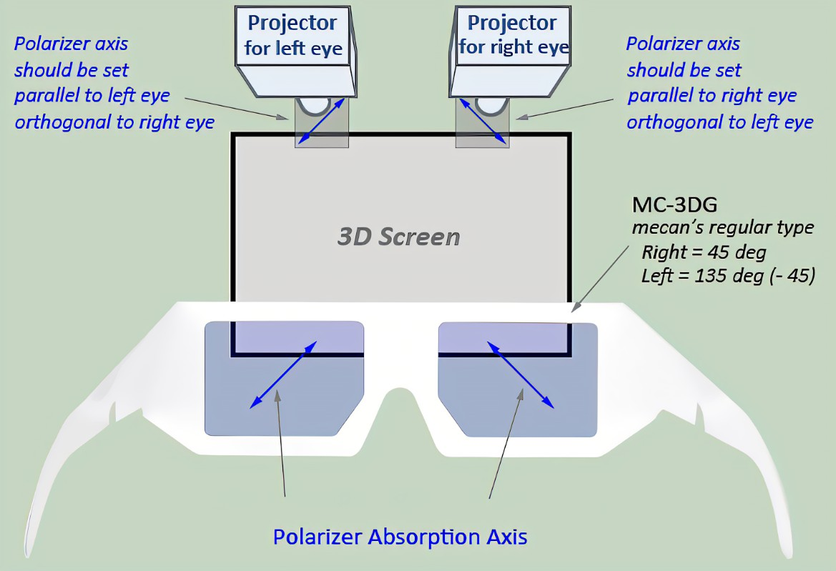

Slide 25
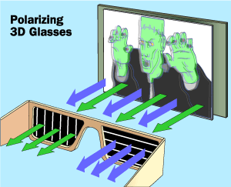

Slide 26
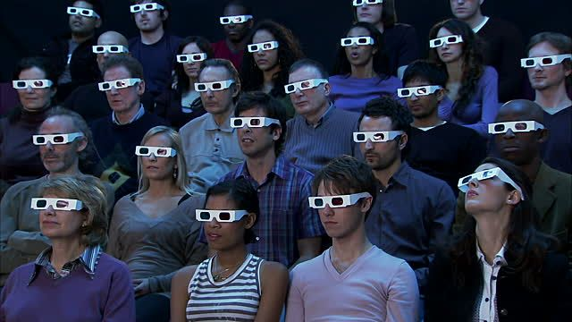
Anaglyph Glasses

Slide 27
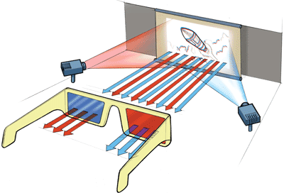

Slide 33
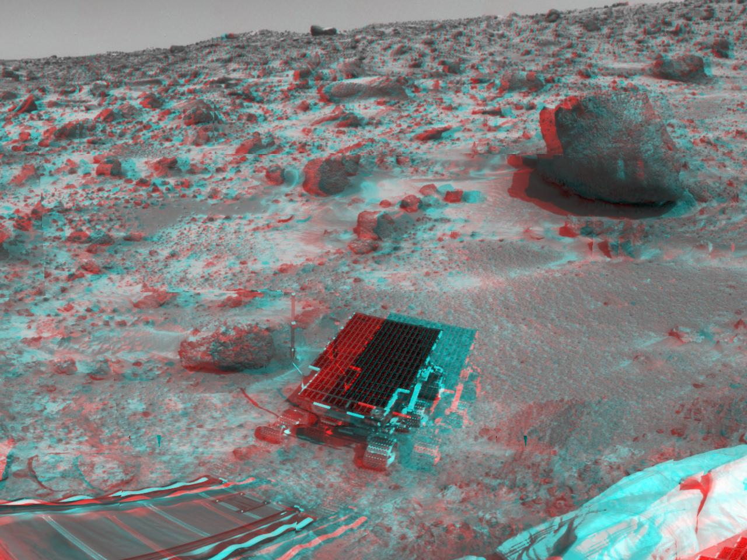
Mars Rover
Spirit

Slide 36
https://www.youtube.com/watch?v=VMdcuqMfjSQ
3D Video Extreme Teeth!!! – YouTube
3D Video EXTREME UFO - https://www.youtube.com/watch?v=QJnDTuPt_2oTube

Slide 37
Pin Hole Lenses

Slide 38
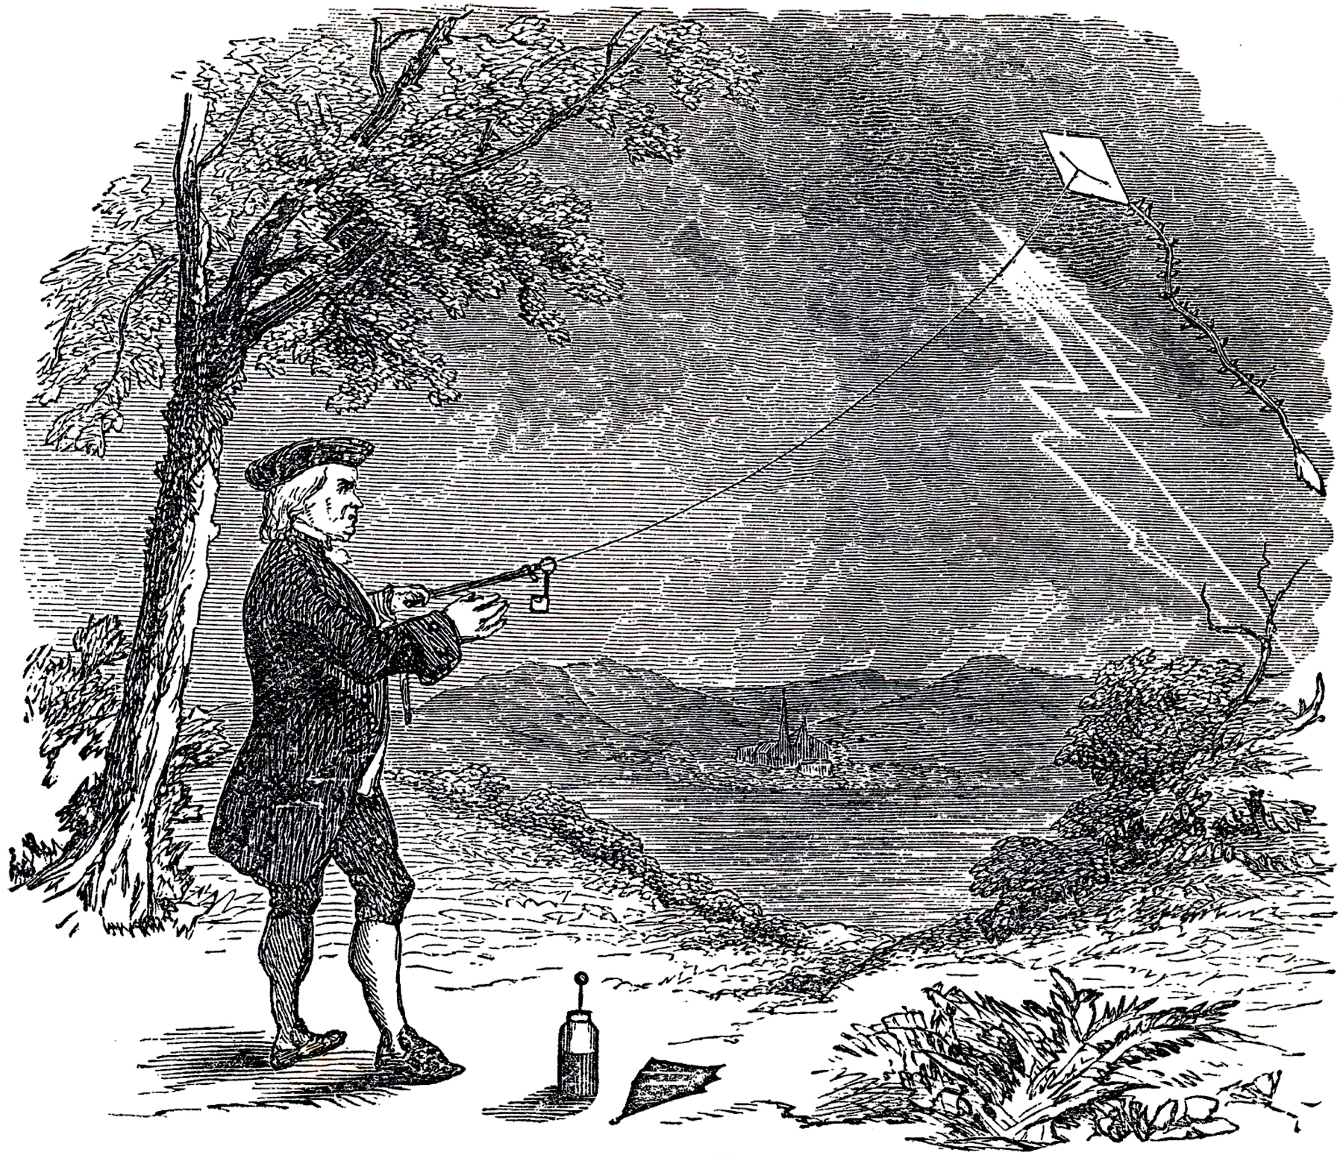
Franklin and Electricity

Slide 39
Important discoveries:

Slide 41
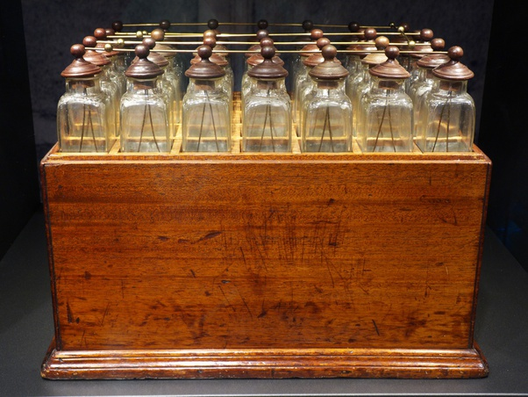
Franklin’s Leyden Jar “battery”

Slide 46
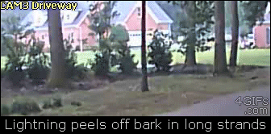

Slide 47
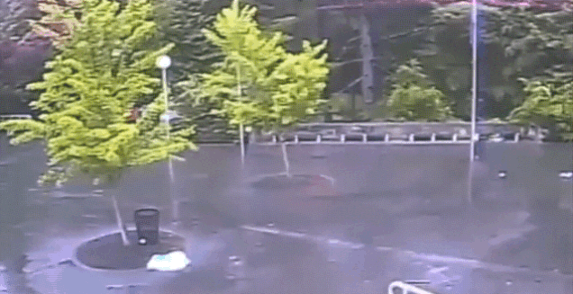

Slide 51
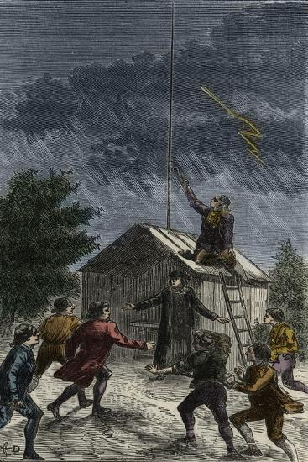
Sentry Box Thomas Francois Dalibard 1752

Slide 52
Lightning and electricity!

Slide 53
Franklin’s Lightning Rod Franklin Institute
Reproduction
By Robert Wickie

Slide 54
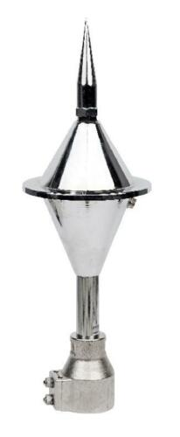
Modern Lightning Rod

Slide 55
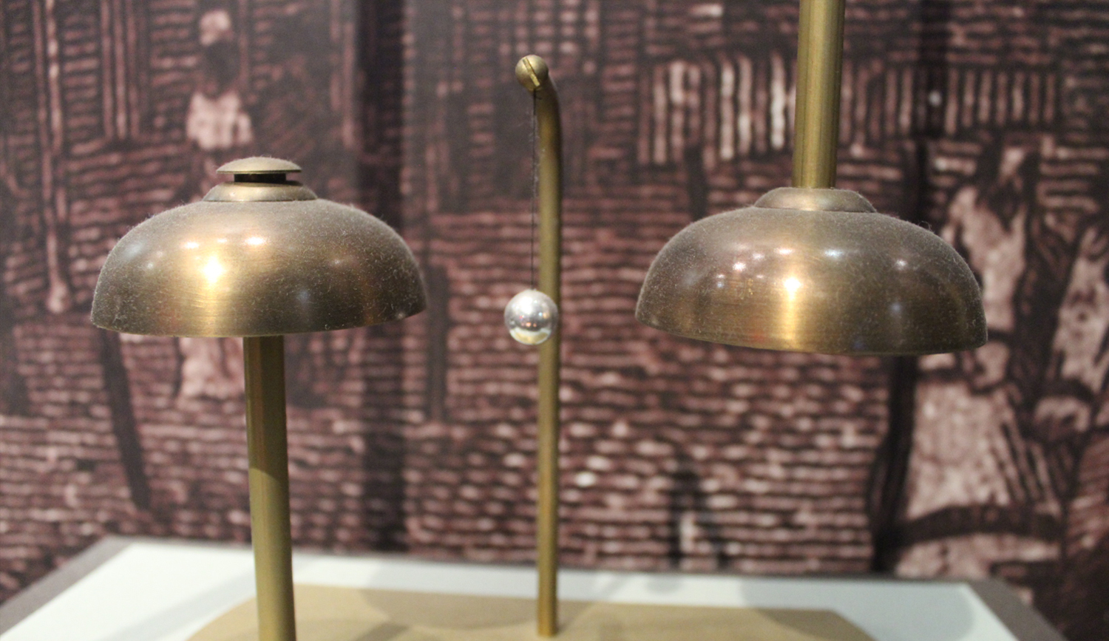
Franklin’s Lightning Bell

Slide 56
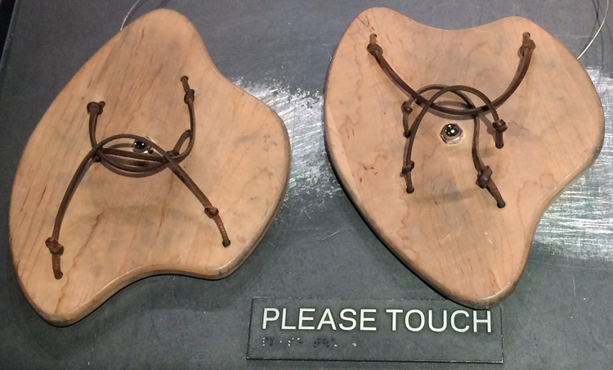
Discoveries and Inventions of Benjamin Franklin Part 2
Lemelson Foundation

Slide 57
Eureka Lightning Rod Simpson-Vance House RCAA 904 G Street

Slide 58
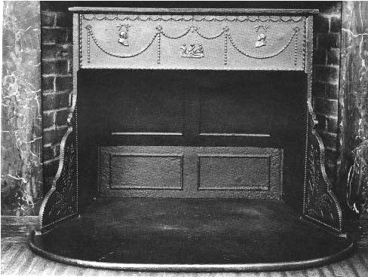
Franklin Stove

Slide 59
Heat Transfer

Slide 60
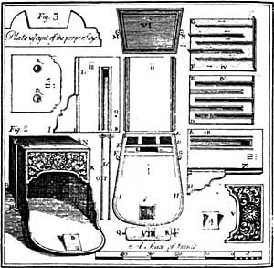
The Franklin Stove

Slide 61
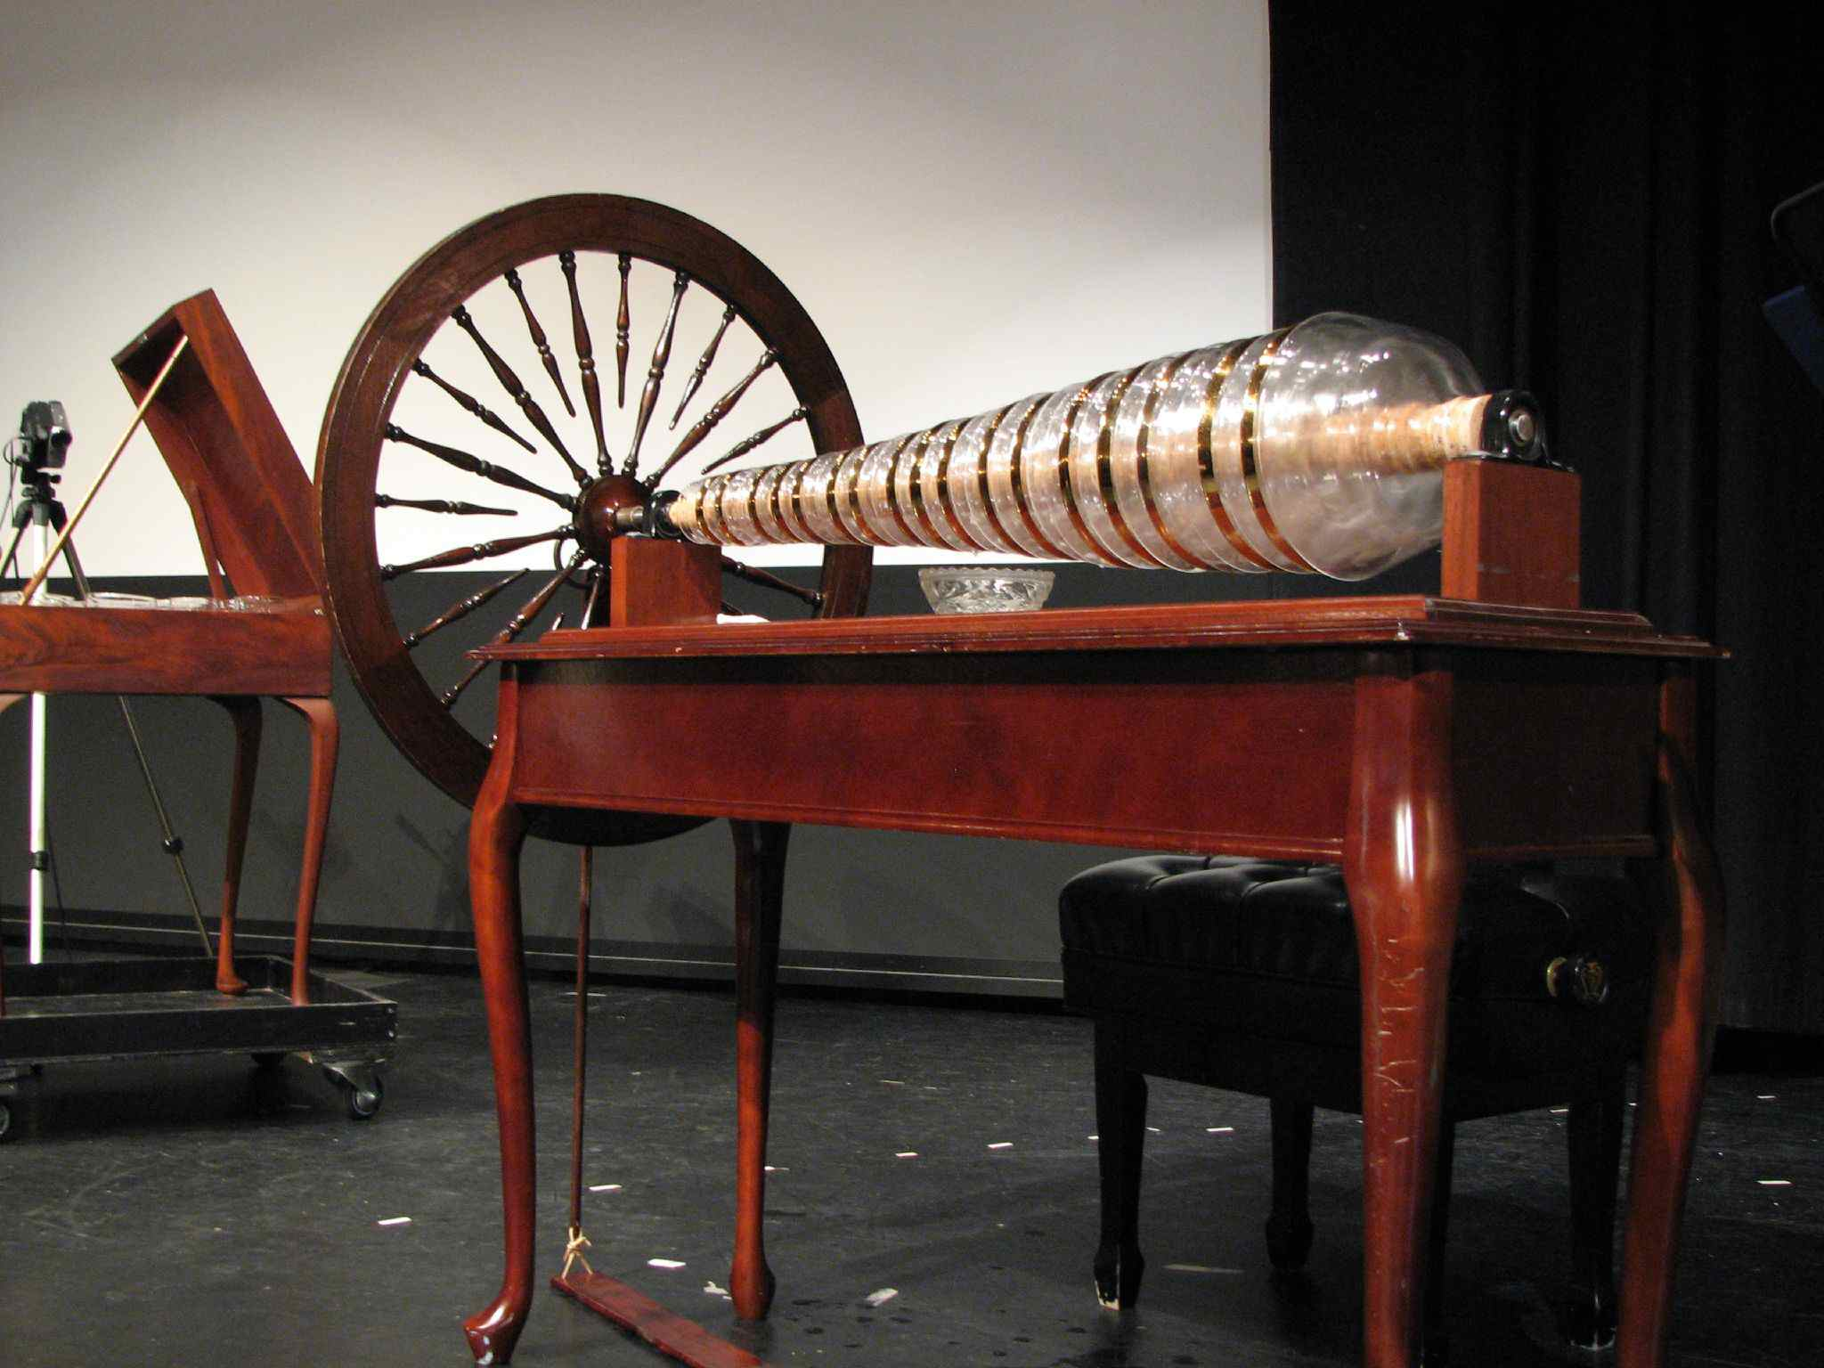
The Armonica

Slide 62
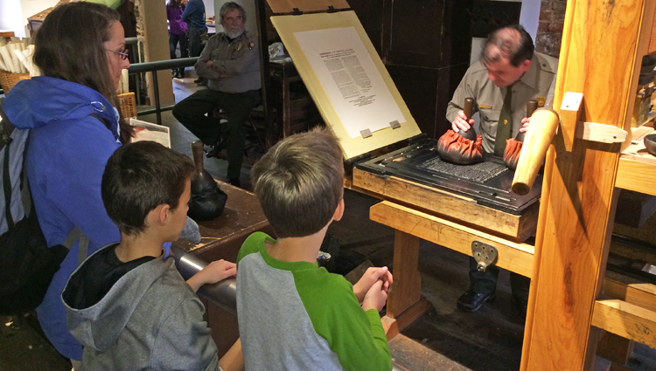
Franklin and the Printing Press

Slide 63
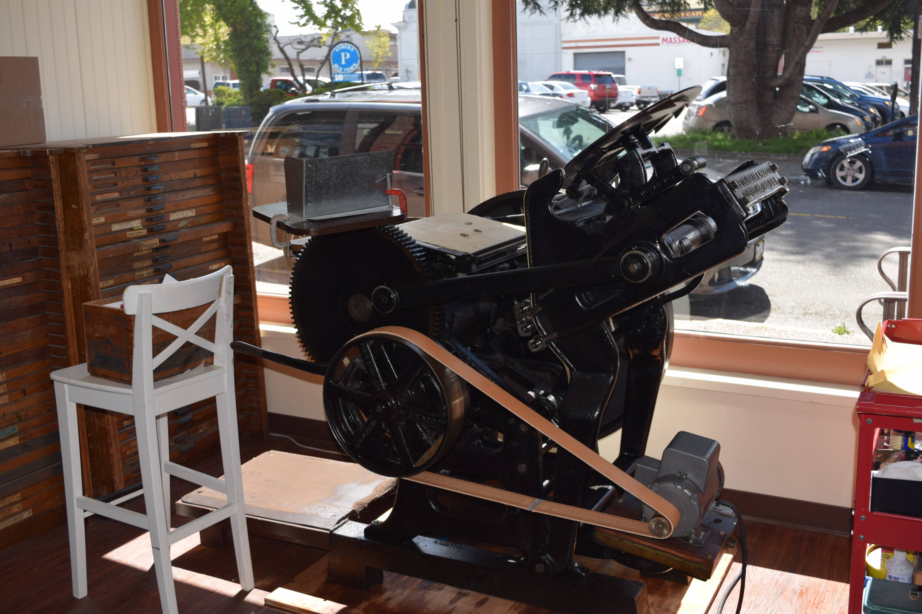

Slide 64
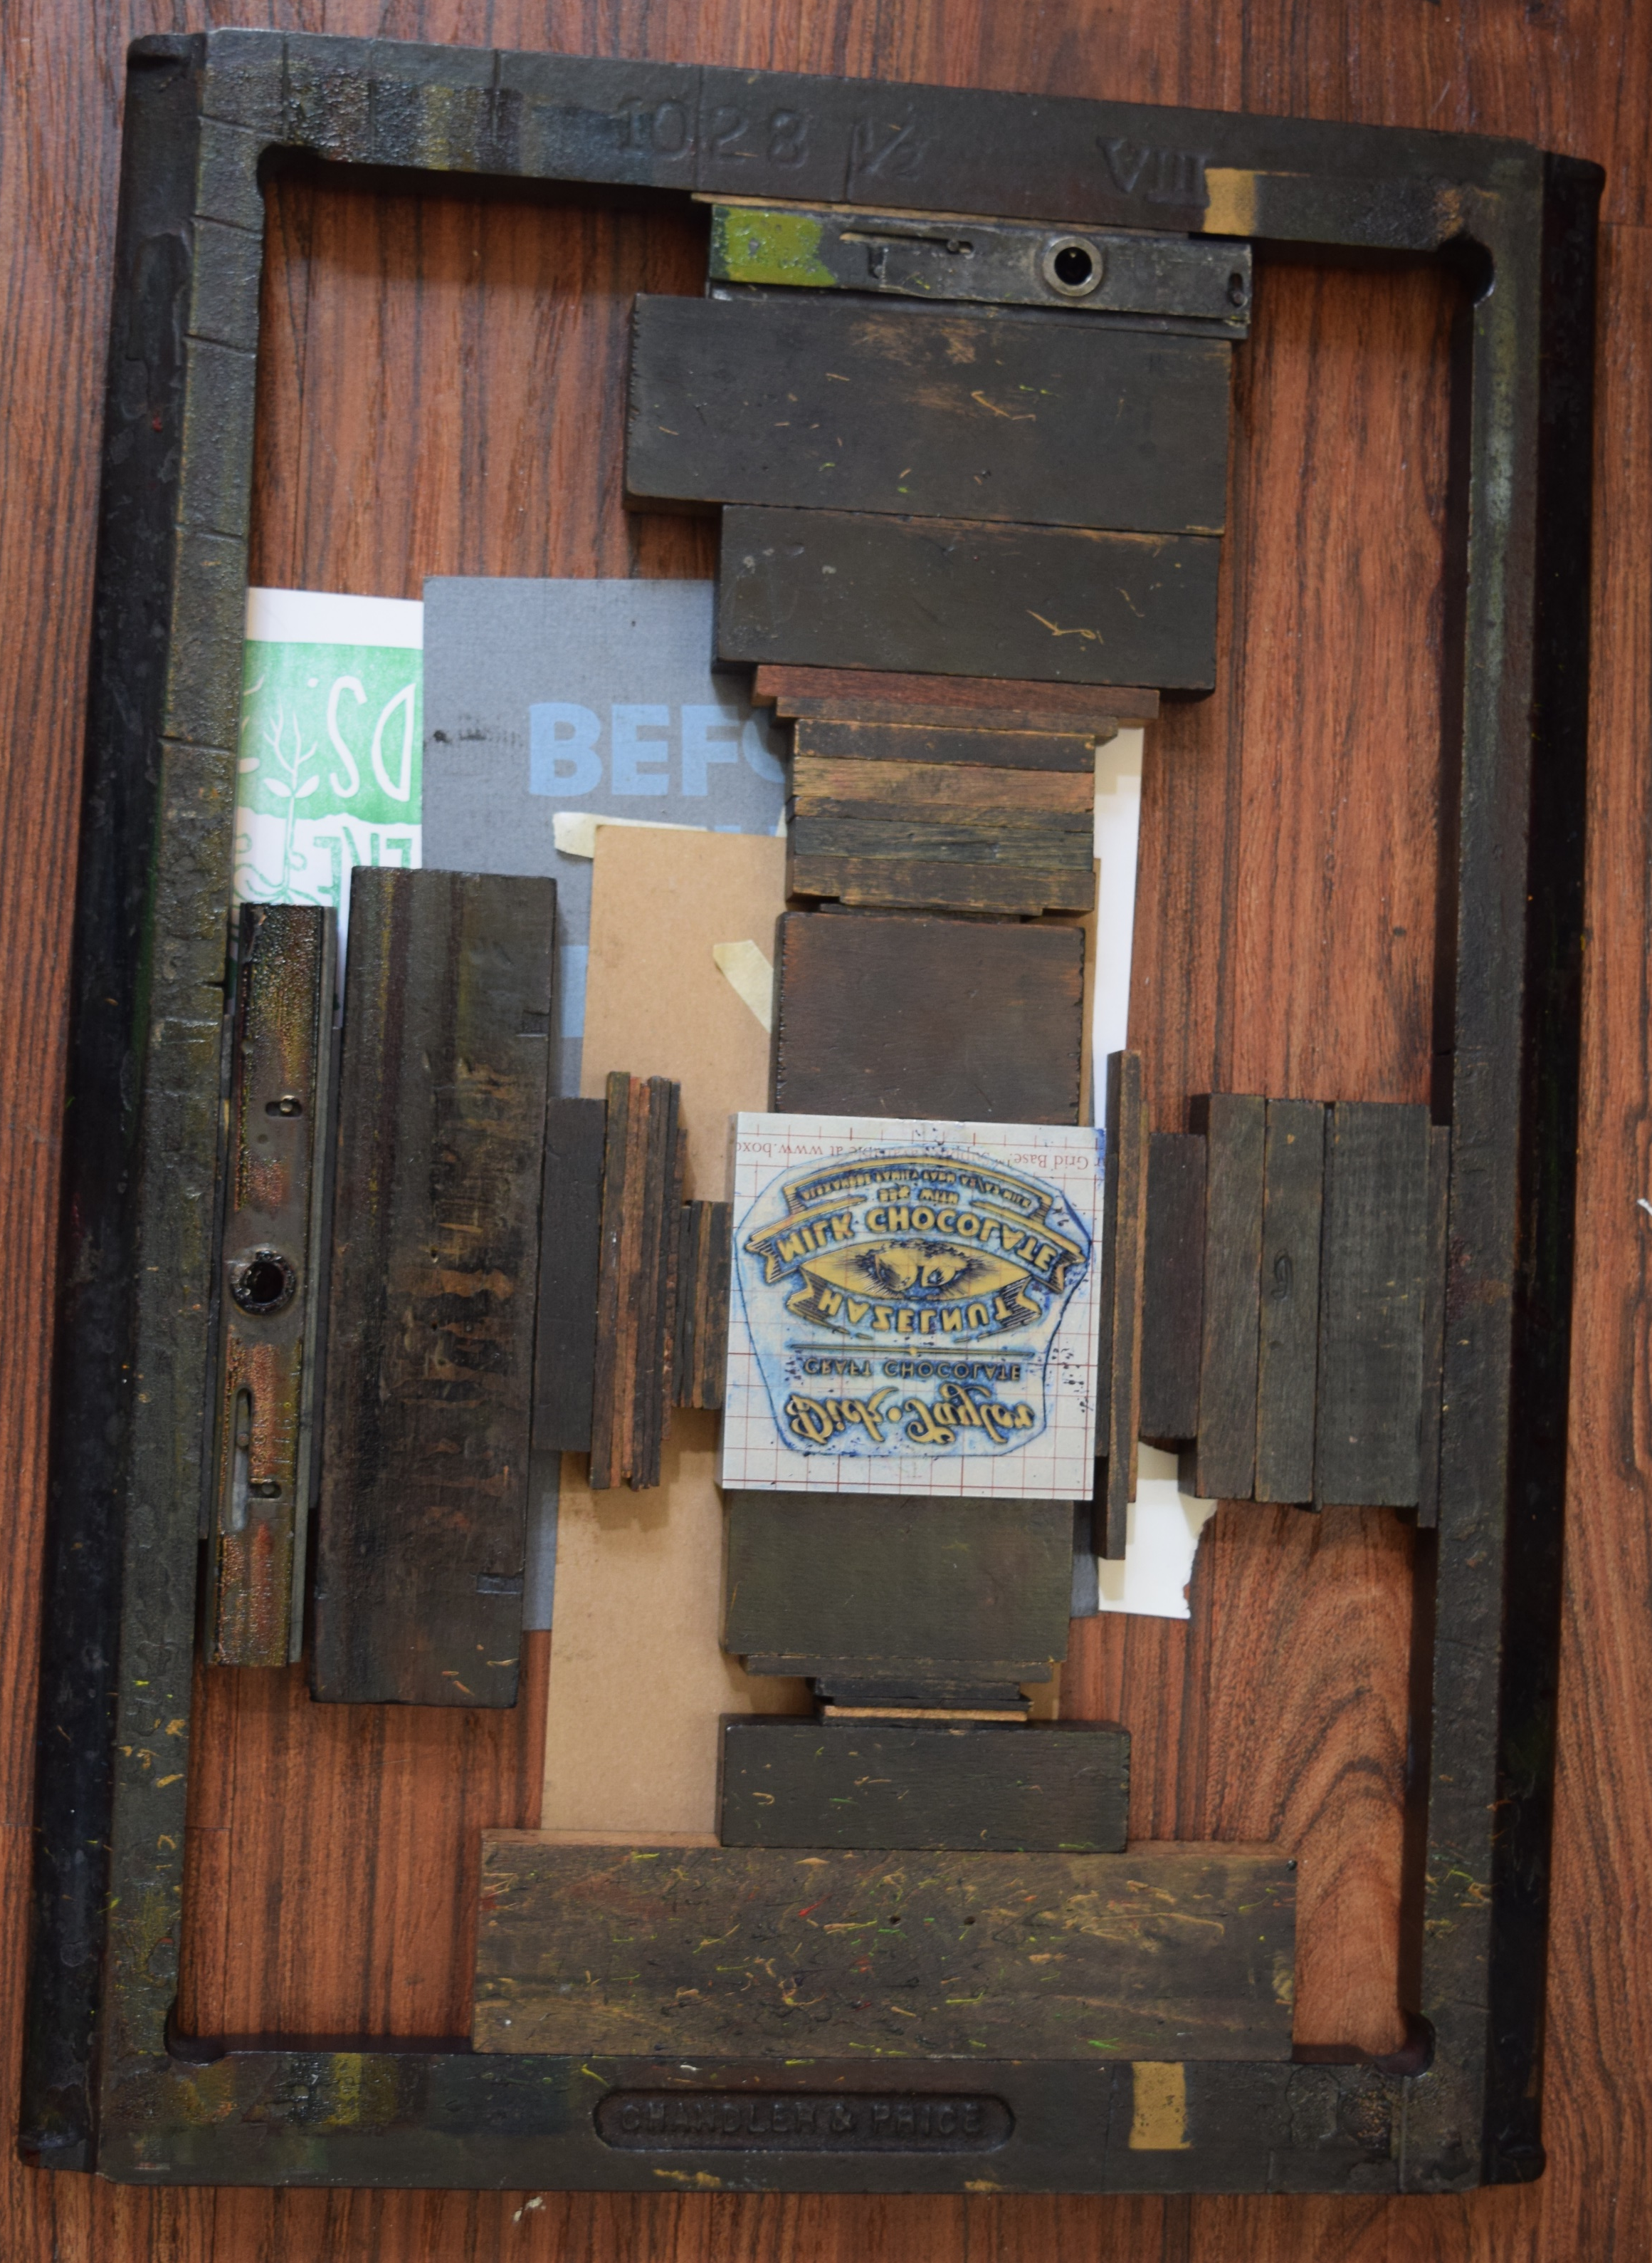

Slide 65
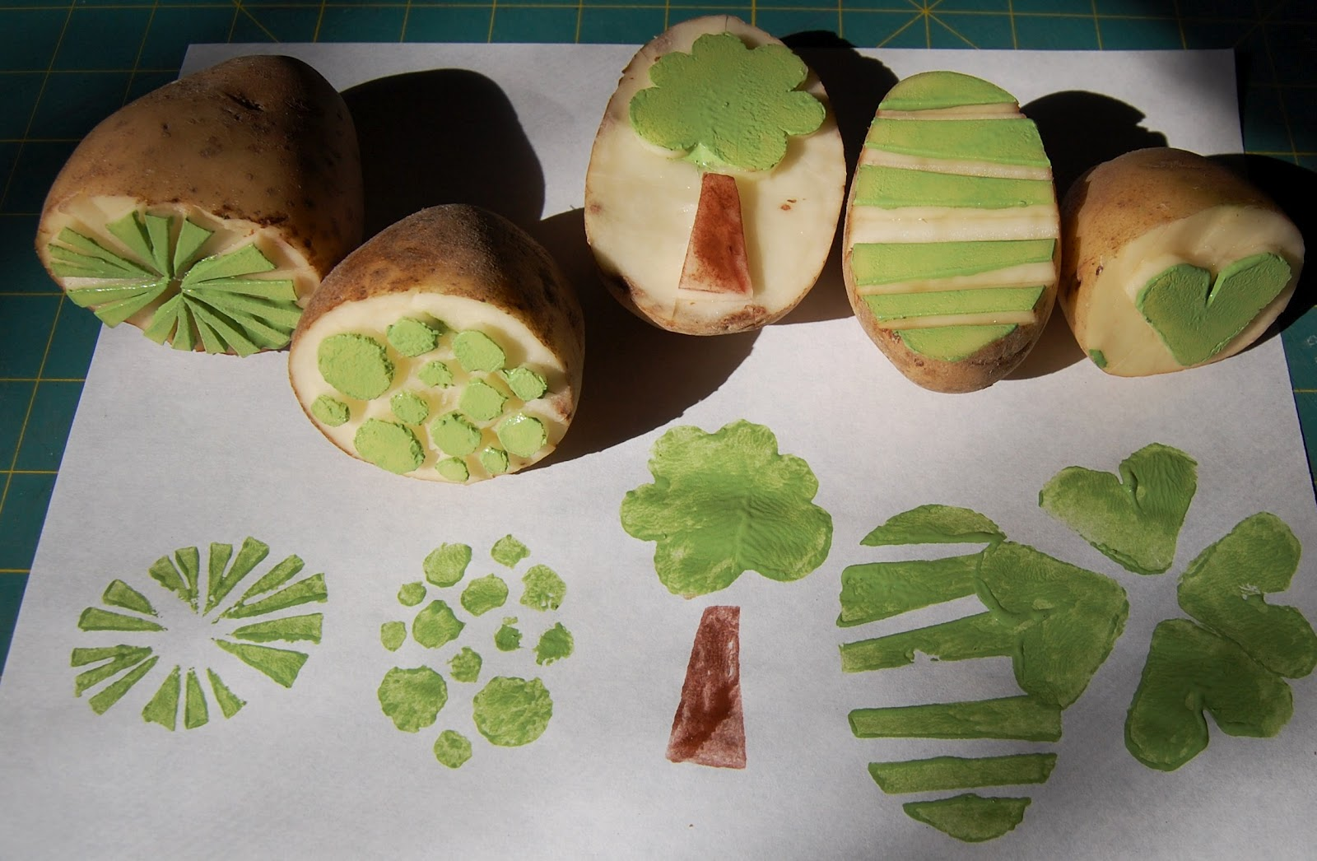
Potato & Vegetable Prints

Slide 66
Insert the digits 1-9 in the boxes so that each row, column and diagon has the same sum

